Slide 1
THE TARGETED BOYCOTT CAMPAIGN
Make complicity untenable
What Israel is doing to Palestinians in Gaza, why it is genocide, and how each of us can move the contracts and investment that sustain it.
[Speaker name] · [Organisation] · [Date]
palestiniangenocide.org
Notes:
Replace the speaker, organisation and date. Introduce yourself and why you are here. The talk has four parts: what is happening, why it is genocide, what everyone can do, and the targeted strategy where most of the leverage is. Allow about 20 minutes plus questions.

Slide 2
A
PART A
What Israel is doing to Palestinians in Gaza
The figures come from Palestinian health authorities, the UN, and humanitarian and press freedom organisations.
Part A · What is happening 2 / 19
palestiniangenocide.org
Notes:
Start before October 2023: in July 2024 the International Court of Justice found that Israel's continued presence in the Occupied Palestinian Territory is unlawful. Keep this part human. Each figure is a person, a family, a profession. If you have permission to share a story from someone in Gaza, this is the place for it.

Slide 3
THE HUMAN TOLL
The people Israel has killed
74,000+
189
394
Palestinians killed in Gaza
Palestinian journalists and media workers killed by Israel in Gaza
UNRWA colleagues killed in Gaza
At least 21,000 of them children.
311 UN agency staff and 83 people working with them, and 1,022 incidents affecting UNRWA premises.
Gaza's Health Ministry, via Human Rights Watch, 10 October 2026
Committee to Protect Journalists, 24 September 2026
UNRWA Situation Report #235, 24 September 2026
Part A · What is happening 3 / 19
palestiniangenocide.org
Notes:
Read each figure slowly. The journalists are the people who documented the assault, and Israel has now killed more journalists and media workers than any other government since the Committee to Protect Journalists began collecting data in 1992. UNRWA colleagues are UN staff and the people working with them. Check the latest figures on palestiniangenocide.org before you present: they rise every week.

Slide 4
THE CONDITIONS OF LIFE
Israel starved Gaza and cut its water
Famine
4.74 litres
A graveyard
confirmed in Gaza Governorate
of water a day per person in Gaza
for thousands of children
The world's famine authority confirmed famine, its highest phase, with reasonable evidence.
Israel's cutting of external water supply and destruction of water facilities reduced the water available by 94%.
"Gaza has become a graveyard for thousands of children. It's a living hell for everyone else."
IPC Famine Review Committee, 22 August 2025
Oxfam, July 2024
UNICEF, 31 October 2023
Part A · What is happening 4 / 19
palestiniangenocide.org
Notes:
Famine was confirmed by the IPC Famine Review Committee, the world's famine authority, on 22 August 2025. Oxfam found that Israel's cutting of external water supply and destruction of water facilities reduced the water available in Gaza by 94%. UNICEF said Gaza had become a graveyard for children within weeks of the assault beginning.

Slide 5
B
PART B
It is genocide
UN investigators, human rights organisations, humanitarian agencies and genocide scholars have reached the same conclusion, and the International Court of Justice has ordered Israel to prevent acts of genocide.
Part B · It is genocide 5 / 19
palestiniangenocide.org
Notes:
You will be asked whether "genocide" is the right word. This part answers it: who found it, and when.

Slide 6
WHAT THE COURTS HAVE FOUND
The world's courts have acted
Jan 2024
Jul 2024
Nov 2024
Oct 2025
International Court of Justice
International Court of Justice
International Criminal Court
International Court of Justice
A real and imminent risk to the right of Palestinians in Gaza to be protected from acts of genocide. Israel ordered to prevent them.
Israel's occupation of Palestinian territory is unlawful. States must prevent trade and investment that help maintain it.
Arrest warrants for Israel's prime minister and former defence minister, including for the war crime of starvation.
Israel must agree to and facilitate UN relief, including UNRWA. Its allegations against UNRWA staff were not substantiated.
Part B · It is genocide 6 / 19
palestiniangenocide.org
Notes:
South Africa's genocide case against Israel continues at the International Court of Justice; the Court has not yet ruled on the merits, so do not say it has ruled that genocide is occurring. What it found in January 2024 was a real and imminent risk, and it ordered Israel to prevent genocidal acts. In March and May 2024 it ordered Israel to let in food and aid and to halt its Rafah offensive. The July 2024 advisory opinion held the occupation unlawful, and that states must not entrench it through trade. The ICC warrants are for Benjamin Netanyahu and Yoav Gallant.

Slide 7
UN COMMISSION OF INQUIRY, 16 SEPTEMBER 2025
“The State of Israel is responsible for the commission of genocide against the Palestinians in Gaza.”
Independent International Commission of Inquiry on the Occupied Palestinian Territory, A/HRC/60/CRP.3, para. 240
It also found that Israel has failed to prevent and to punish genocide.
Part B · It is genocide 7 / 19
palestiniangenocide.org
Notes:
This is the clearest finding from a UN-mandated body: an independent inquiry appointed by the UN Human Rights Council. It concluded that genocide is being committed, and that Israel has failed to prevent and punish it (para. 243).

Slide 8
THEY AGREE
Genocide, in their words
March 2024
December 2024
December 2024
July 2025
UN Special Rapporteur
Amnesty International
Human Rights Watch
B'Tselem
"There are reasonable grounds to believe that the threshold indicating Israel's commission of genocide is met."
"Israel has committed and is continuing to commit genocide against Palestinians in the occupied Gaza Strip."
"…the crime against humanity of extermination and acts of genocide."
"…Israel is taking coordinated action to intentionally destroy Palestinian society in the Gaza Strip."
August 2025
September 2025
December 2023
May 2024
Genocide scholars (IAGS)
Médecins Sans Frontières
FIDH
Lemkin Institute
"Israel's policies and actions in Gaza meet the legal definition of genocide…"
"Israel is committing genocide against Palestinians in Gaza and doing so with absolute impunity."
"Israel's actions against the Palestinian people constitute an unfolding genocide."
"Let us be clear: Israel is committing genocide in Gaza."
Part B · It is genocide 8 / 19
palestiniangenocide.org
Notes:
These are human rights organisations (including B'Tselem, one of Israel's own), a medical charity that works in Gaza, and the world's main association of genocide scholars. Human Rights Watch found that depriving Palestinians in Gaza of water amounted to extermination and acts of genocide. Every source is linked on palestiniangenocide.org/boycott/resources/authoritative-determinations-gaza/.

Slide 9
C
PART C
What everyone can do
Every one of these helps. Pick the ones that fit your life, and do them together.
Part C · What everyone can do 9 / 19
palestiniangenocide.org
Notes:
Ask the room what they already do. Most people do some of these; the point is to do more of them, and together.

Slide 10
WAYS TO ACT
Eight things anyone can do
Share the evidence
Write to your representatives
March and protest
Boycott as a consumer
Post the findings and the figures, with their sources. Correct the "conflict" framing.
Ask for an end to arms sales, for sanctions, and for an end to trade with the settlements.
Turn up, lawfully and peacefully. Numbers show politicians where the public stands.
Follow the targeted consumer boycotts called by the Palestinian BDS National Committee.
Move your money
Organise at work
Give
Report what you know
Ask your bank and pension fund what they hold, and move if they will not act.
Raise it with colleagues and your union. Ask what your employer buys and from whom.
Support Palestinian-led and humanitarian organisations working in Gaza and the West Bank.
Contracts, tenders, holdings. Send it through the encrypted form on the site.
Part C · What everyone can do 10 / 19
palestiniangenocide.org
Notes:
Go through these quickly. The last four are where professionals have particular power: your bank, your pension, your employer, and what you know from your job. The report form encrypts what you send in your browser before it leaves your device. Add or replace actions for your own group.

Slide 11
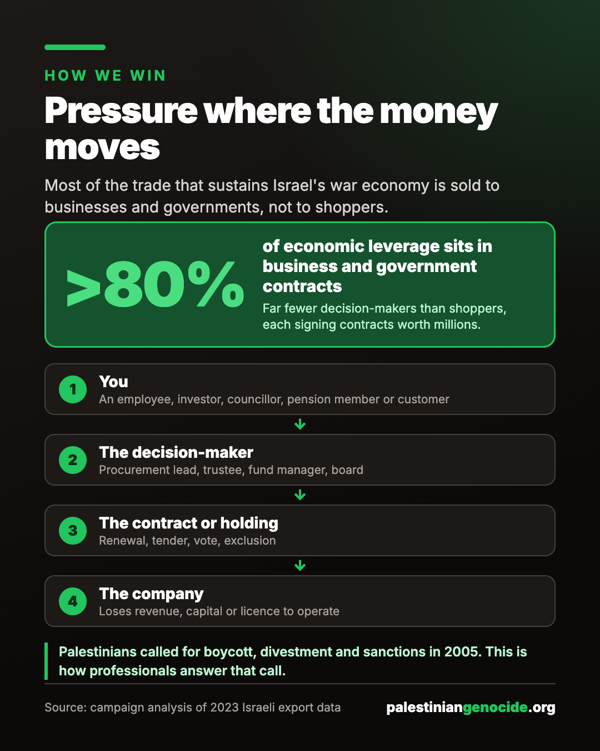
WHY A TARGETED STRATEGY
Most of the money moves between businesses and governments
Over 80% of economic leverage sits in business and government contracts, not consumer goods.
Those contracts are signed by far fewer people: procurement leads, trustees, fund managers, boards.
Many of us work for, invest through or vote for those people. That is where the targeted strategy starts.
Part C · What everyone can do 11 / 19
palestiniangenocide.org
Notes:
This is the bridge to the last part. Consumer boycotts matter and work best on brands. But most of the trade that sustains Israel's war economy is sold to businesses and governments. The figure comes from the campaign's analysis of 2023 Israeli export data.

Slide 12
D
PART D
The targeted strategy
Find the contract that serves Israel's military or occupation, find who decides, and give them reasons they cannot ignore.
Part D · The targeted strategy 12 / 19
palestiniangenocide.org
Notes:
This part explains the method behind palestiniangenocide.org: research, the four risks, choosing targets, and finding your own place.

Slide 13
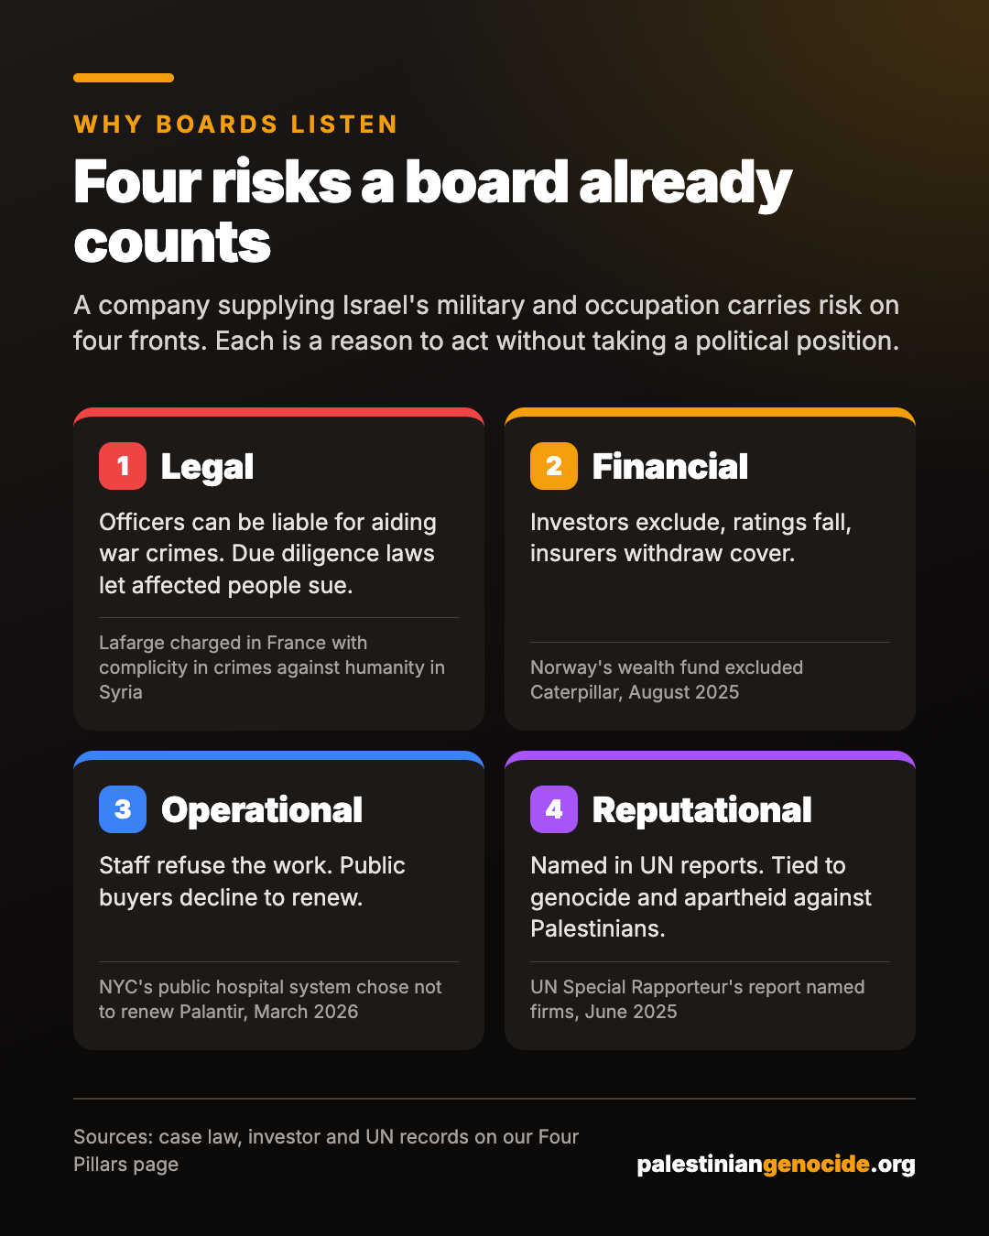
WHY BOARDS LISTEN
Four risks a board already counts
Legal: officers can be held personally liable for aiding war crimes, and France's due diligence law lets affected people sue.
Financial: investors exclude, ratings fall, insurers withdraw cover.
Operational: staff refuse the work, and public buyers decline to renew.
Reputational: named in UN reports, and tied to genocide and apartheid against Palestinians.
Part D · The targeted strategy 13 / 19
palestiniangenocide.org
Notes:
When you write to a company, a pension fund or a procurement team, speak in these four terms. They are the risks the board already measures, so they can act on them without taking a political position. Real cases for each are on the Four Pillars page.

Slide 14
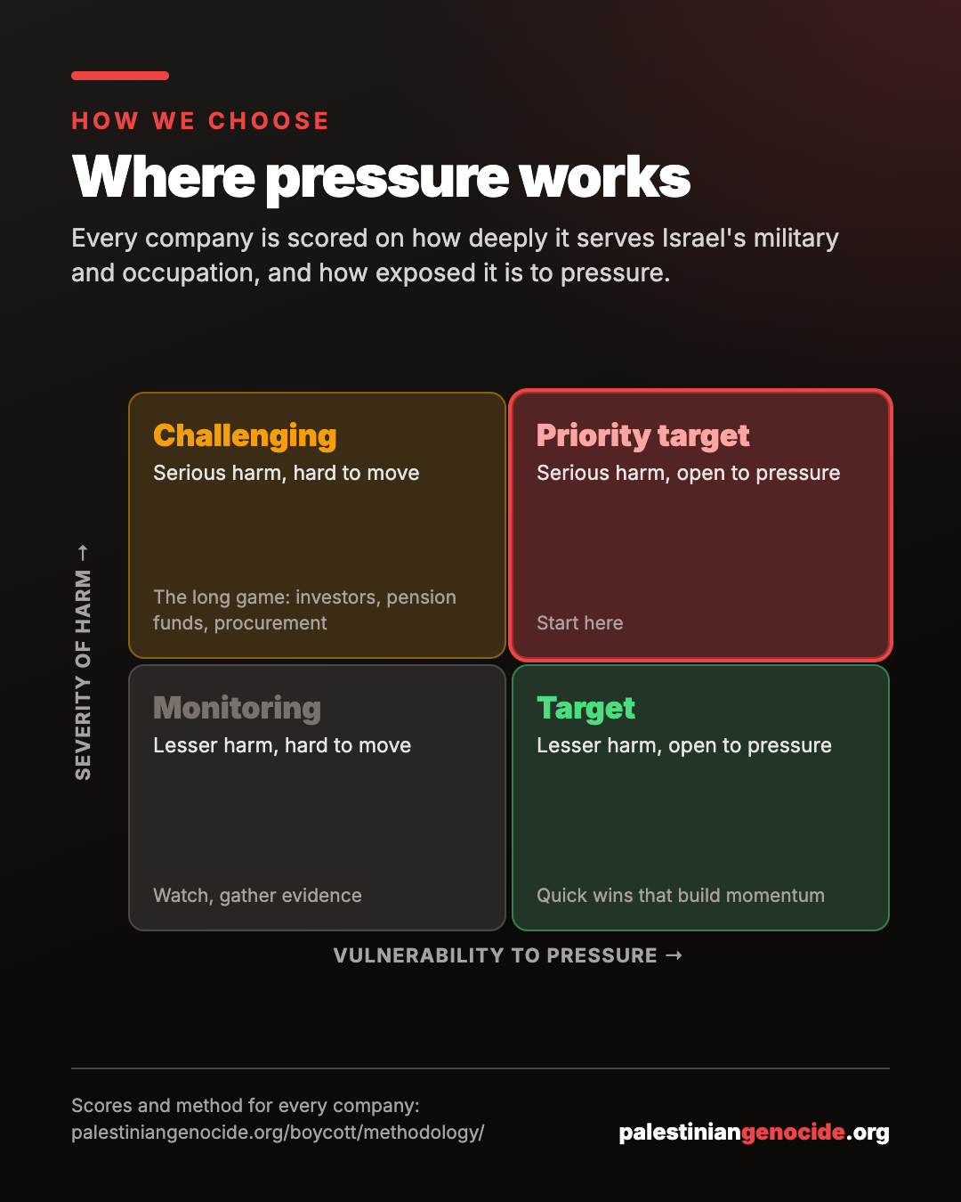
HOW WE CHOOSE
Every company is scored, and placed
Severity: how deeply the company serves Israel's military and occupation.
Vulnerability: how exposed it is to pressure.
Priority targets are both: serious harm, and open to pressure. Start there.
Every company's profile shows its scores, its evidence and four actions to take.
Part D · The targeted strategy 14 / 19
palestiniangenocide.org
Notes:
Open the directory at palestiniangenocide.org/boycott/companies/ and show one profile if you can. Each profile has the evidence, the people who decide, and four actions anyone can take.

Slide 15
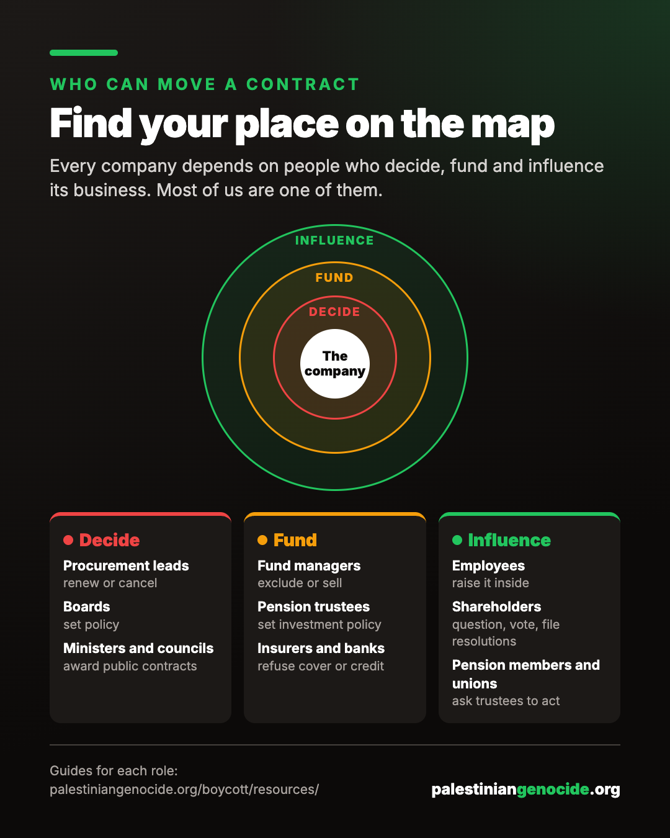
WHO CAN MOVE A CONTRACT
Find your place on the map
Decide: procurement leads, boards, ministers and councils.
Fund: fund managers, pension trustees, insurers and banks.
Influence: employees, shareholders, pension members and unions.
Most of us are in at least one of these rings.
Part D · The targeted strategy 15 / 19
palestiniangenocide.org
Notes:
Ask people to say where they sit: who works in procurement, who has a workplace pension, who is in a union, who knows a councillor. That is the room's leverage.

Slide 16
IT WORKS
Institutions are already moving
August 2025
September 2025
Norway's Government Pension Fund Global excluded Caterpillar and five Israeli banks.
Microsoft disabled the cloud services Israeli military intelligence used to store intercepted Palestinian phone calls.
November 2025
March 2026
Allianz ended general insurance cover for Elbit Systems.
New York City's public hospital system decided not to renew its Palantir contract.
Each was a decision one institution took. Yours can take one too.
Part D · The targeted strategy 16 / 19
palestiniangenocide.org
Notes:
Storebrand, KBC, Argenta and the Dutch pension fund ABP also sold their Palantir holdings between 2024 and 2026. Each company's profile records these decisions with their sources.

Slide 17
OUR CAMPAIGN
Our target: [Company name]
1
2
What it supplies
Who decides here
[From its profile: what it supplies to Israel's military or occupation, and what that does to Palestinians.]
[The procurement lead, trustee, fund or board we can reach.]
3
4
Our ask
Next step
[One clear, lawful ask: do not renew, exclude, disclose, divest.]
[A date, a meeting, a letter, and who is doing it.]
Part D · The targeted strategy 17 / 19
palestiniangenocide.org
Notes:
Fill this in for your own group, or delete it. Take the evidence from the company's profile on palestiniangenocide.org: say what the company supplies and to whom, not that the company itself is committing genocide. Name the role that decides, not a person's private details. Use the letter tool to draft the letter. Ask for something specific that the person you are writing to has the power to do.

Slide 18
THIS WEEK
Four things you can do
1
2
3
4
Find the company
Write the letter
Share the evidence
Report what you know
Look up your employer, pension fund, council or bank's suppliers in the directory.
The letter tool drafts it from the company's profile, addressed to the person who decides.
Posts for any company, evidence cards and infographics, ready to use.
Contracts, tenders, holdings. Encrypted in your browser before it is sent.
/boycott/companies/
/boycott/tool/
/boycott/resources/digital-assets/
/boycott/report/
Part D · The targeted strategy 18 / 19
palestiniangenocide.org
Notes:
End with something people can do before they next meet. Ask each person to commit to one of these out loud.

Slide 19
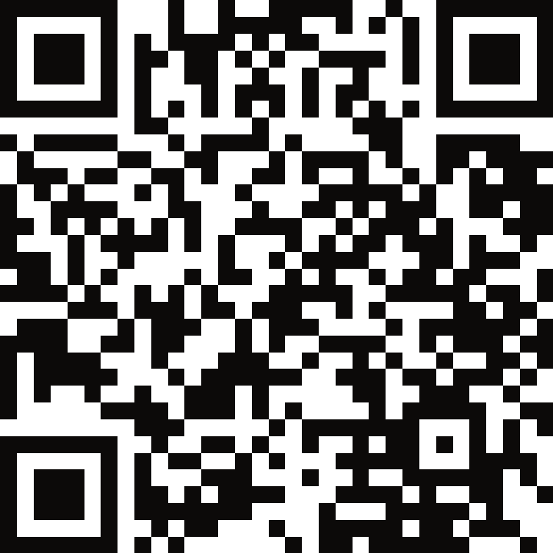
Make complicity untenable
Palestinians called for boycott, divestment and sanctions. Answer where you have power.
Company directory
palestiniangenocide.org/boycott/companies/
Scan for the campaign
Letter tool
palestiniangenocide.org/boycott/tool/
Campaign materials
palestiniangenocide.org/boycott/resources/
palestiniangenocide.org
Notes:
Leave this slide up during questions. The QR code opens the boycott homepage.

